Slide 1

CIND 820 Capstone Project Final Presentation: In-Vehicle Coupon Recommendation
Sucheta Sikdar (ID: 501074722)

Slide 2
Introduction
Coupons are a great way for customers to save money on their purchases and feel special that they are getting a discount. Businesses can attract customers with coupons. If businesses can find the right customers who will use their coupons, then it will help businesses survive and grow. Businesses can then retain existing customers and attract new customers. If businesses know beforehand as to which customers to target for their coupons, then it will save them both money and effort in marketing and sending coupons (Ahmed et al., 2024).
There exists a publicly available dataset called In-Vehicle Coupon Recommendation at UCI Machine Learning Repository from 2020 which describes different driving scenarios of multiple clients and whether the coupon is accepted (UCI Machine Learning Repository, 2020).

Slide 3
Objectives
Find the best predictive classification algorithm for the In-Vehicle Coupon Recommendation dataset (2020) after evaluation of various supervised learning classification algorithms introduced to us in CMTH 642 – Data Analytics: Advanced Methods like Random Forest, Decision Tree, Logistic Regression, Naïve Bayes, k Nearest Neighbours (k-NN) on the dataset.
Using a correlation matrix find out which attributes are highly correlated to the target of the customer accepting or rejecting a coupon. A visual of a correlation matrix will be very effective. Since most of the features are categorical, the discreet values will be converted to corresponding numerical values using encoding.
Find whether we can attain a dataset with fewer dimensions using these 3 methods: Stepwise Regression, Forward Feature Selection and Backward Feature Elimination methods learnt by us in CMTH 642 – Data Analytics: Advanced Methods. This will help eliminate some noise. Dimensionality reduction is the major contribution of this project to this dataset.
Find the limitations of this dataset.

Slide 4
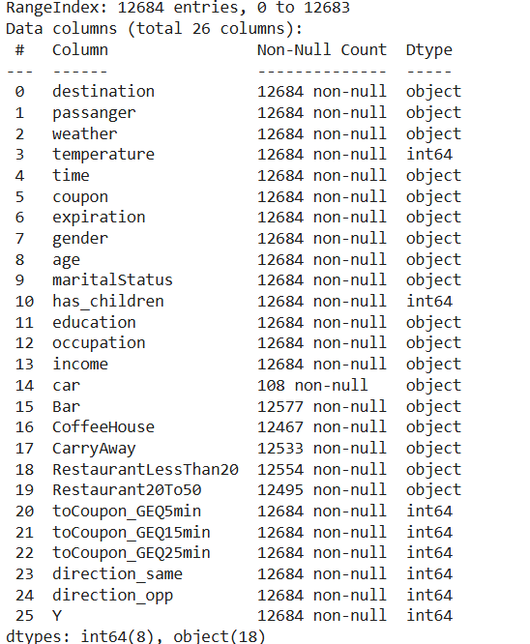
Data Description and Data Preparation
Using Python to yield information on the data:

Slide 5
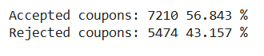
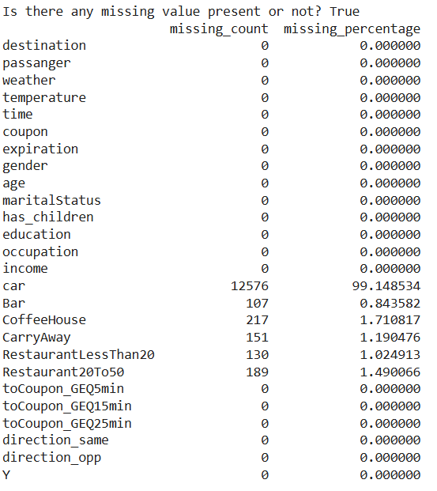
Data Description and Data Preparation contd.
Missing values
Distribution of target class found using Python:
Distribution of Missing values in the dataset found using Python:

Slide 6
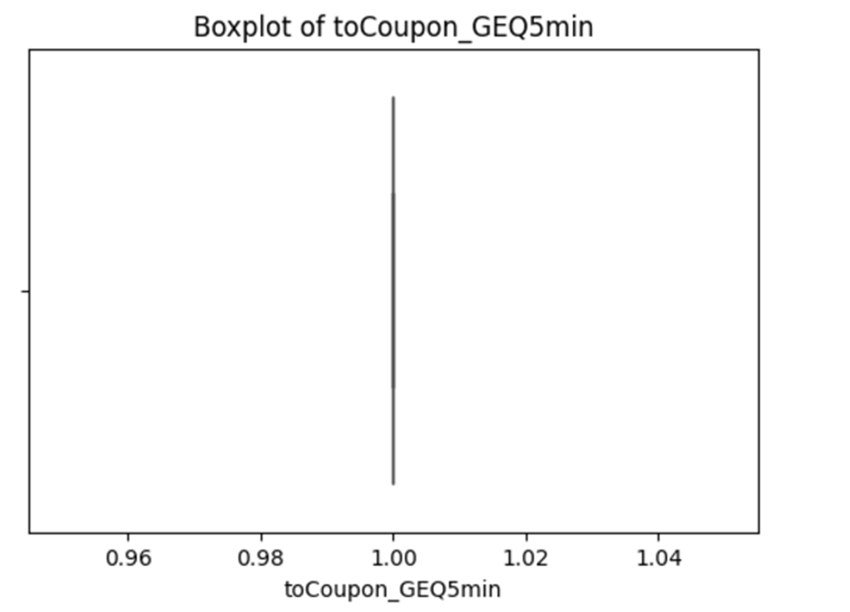
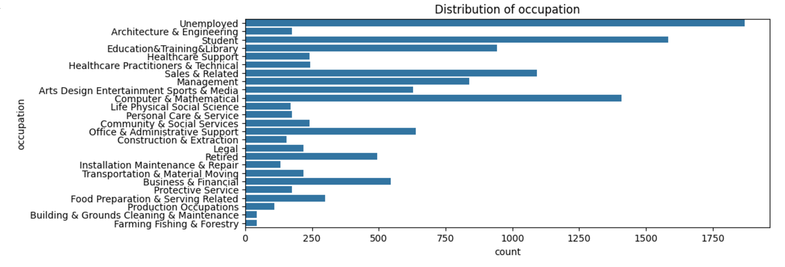
Data Description and Data Preparation contd.
Dropped column Car as it has too many missing values
Used Python to generate box plots of numerical variables. Dropped column toCoupon_GEQ5min because there is no variability in its value
Used Python to observe the distribution of categorical variables. Dropped column occupation because it has too many categories that leads to a lot of noise.

Slide 7
Data Description and Data Preparation contd.
Frequent value / mode imputation for missing values in data. Atiq et al. (2022) demonstrated pretty good accuracy when using frequent value imputation for missing values in the dataset along with the algorithms: Random Forest, Decision Tree, Logistic Regression, Gradient Boosted Tree, Naïve Bayes and Deep Learning. Therefore, this project used frequent value imputation too for the remaining missing values.
Did a covariance matrix using Python. Since direction_same has same covariance values as direction_opp, just different sign. It makes sense to just have one on them and reduce the noise.

Slide 8
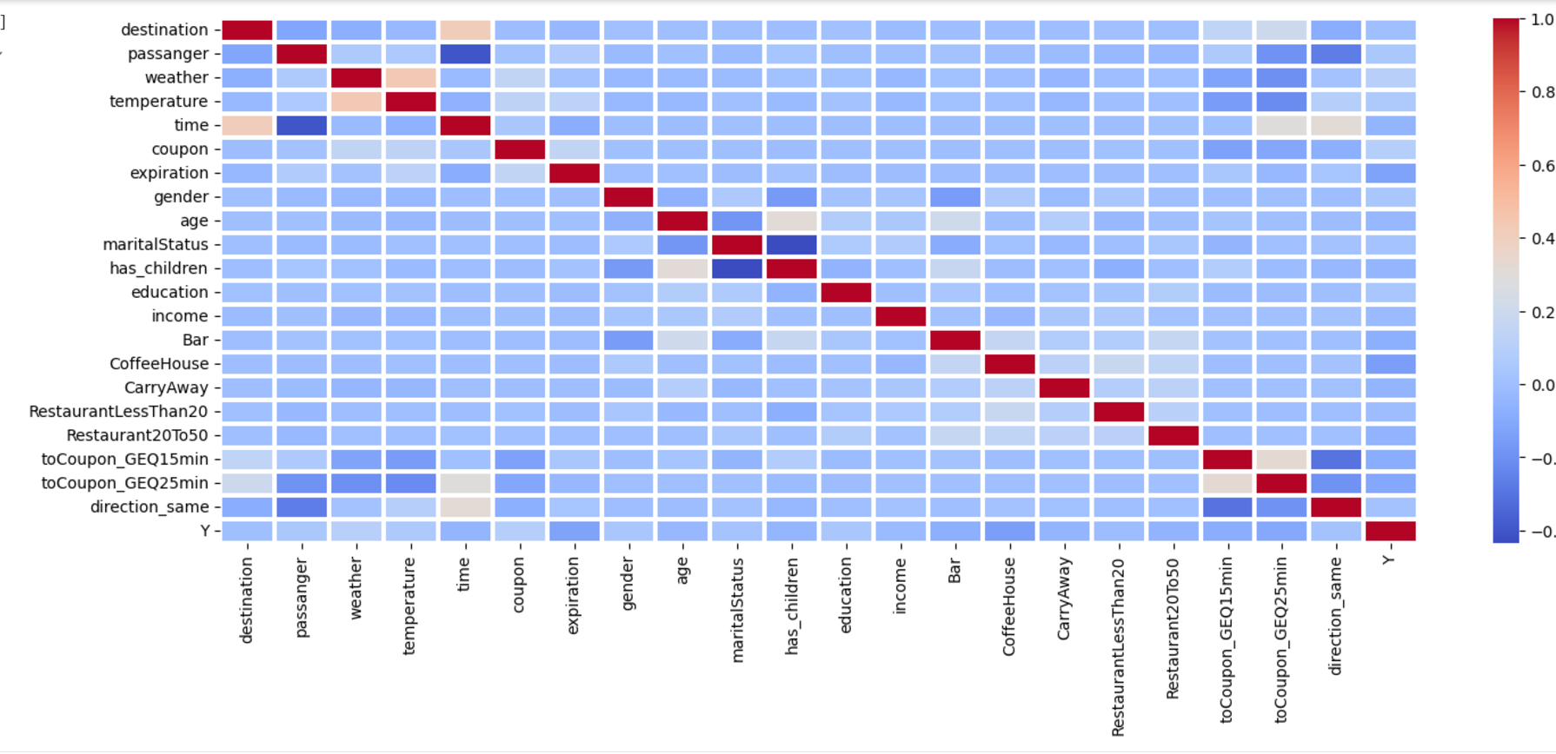
Data Description and Data Preparation contd.
Used a Heat map on correlation matrix to visually catch high correlation.
There seems to be a correlation between time and destination, between temperature and weather, between marital status and has children, between passenger and time, between to coupon GEQ 15 min and same direction. There seems to be correlation of the following features with the target Y: expiration, CoffeeHouse, toCoupon_GEQ15min, toCoupon_GEQ25min.

Slide 9
Dimensionality Reduction
Stepwise Regression
I choose alpha to be 0.05. Coefficients having a p-value of 0.05 or less will be statistically significant.
Iteration 1: Bar has 0.779 for p-value. Bar will be dropped. It is the least statistically significant.
Iteration 2: CarryAway is least statistically significant because it has highest p-value of 0.713 which is greater than alpha of 0.05. CarryAway should be dropped.
Iteration 3: Restaurant20To50 is least statistically significant because it has highest p-value of 0.576 which is greater than alpha of 0.05. Restaurant20To50 should be dropped.
Iteration 4: Income is least statistically significant because it has highest p-value of 0.405 which is greater than alpha of 0.05. income should be dropped.
Iteration 5: Age is least statistically significant because it has highest p-value of 0.166 which is greater than alpha of 0.05. age should be dropped.

Slide 10
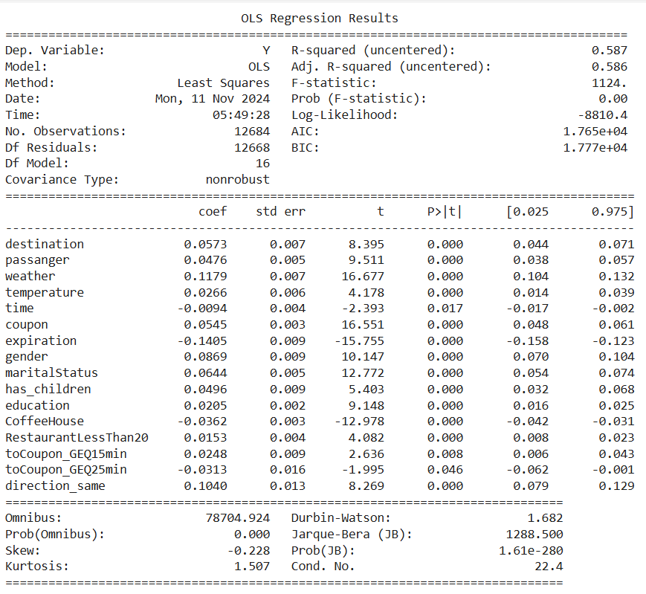
Dimensionality Reduction contd.
After 5 iterations, all coefficients are statistically significant. Therefore, age, income, Restaurant20To50, CarryAway and Bar features are dropped to create a dataset that is dimensionally reduced due to stepwise regression. This leads to a dataset with 16 features.

Slide 11
Dimensionality Reduction contd.
Forward Feature Selection
Backward Feature Elimination
I wanted to keep the same number of features as the dataset reduced by stepwise regression, so I picked 16 features for generating dataset generated by forward feature selection and dataset generated by backward feature elimination. I wanted consistency.
It was observed that the results of Forward Feature Selection and Backward Feature Elimination are the same and give the same reduced dataset.
Thus, there are 2 dimensionally reduced datasets:. the one reduced using stepwise regression and the other reduced using backward feature elimination/forward feature selection.

Slide 12
Classification Algorithms and Cross Validation
The performance of 5 classification algorithms was evaluated over each of the 2 dimensionally reduced datasets:
Random Forest
Logistic Regression
k Nearest Neighbours (k-NN)
Naïve Bayes
Decision Tree
Cross Validation was used and the dataset was split into test and training sets. 20% of dataset was set for testing each time for consistency.

Slide 13
Accuracy and AUC on Dimensionally reduced data using different classification algorithms
Classification Algorithm | Dimensionality Reduction Method | Accuracy | AUC
Random Forest | Stepwise regression | 0.6862 | 0.7351
 | forward feature selection/backward feature elimination | 0.7335 | 0.7943
Logistic Regression | Stepwise regression | 0.6244 | 0.6600
 | forward feature selection/backward feature elimination | 0.6267 | 0.6606
k Nearest Neighbours (k-NN) | Stepwise regression | 0.6847 | 0.7027
 | forward feature selection/backward feature elimination | 0.6460 | 0.6774
Naïve Bayes | Stepwise regression | 0.5881 | 0.6340
 | forward feature selection/backward feature elimination | 0.5905 | 0.6393
Decision Tree | Stepwise regression | 0.6602 | 0.6612
 | forward feature selection/backward feature elimination | 0.6618 | 0.6584

Slide 14
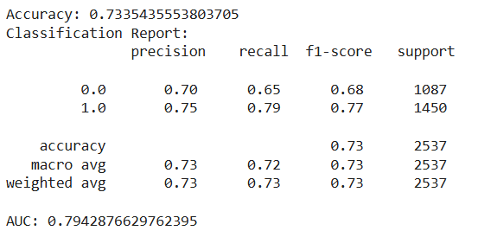
Interpretability and Insights
Random forest on dataset reduced using forward feature selection/backward feature elimination had the highest accuracy and AUC value closest to 1. The Area Under Curve (AUC) close to 1, shows the high predictive power.
Generated by Python for Random Forest on the dataset reduced by forward feature selection/backward feature elimination:

Slide 15
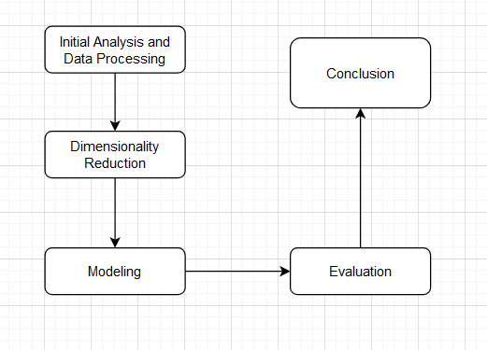
Methodology

Slide 16
Limitations / Challenges / Continuity
Most of the Car feature had missing values and hence the feature could not be used. This is in-vehicle coupon recommendation, hence maybe Car feature was critical in determining whether the coupon would be accepted or not.
This dataset is partially balanced. The results of supervised learning algorithms used to make predictions would skew slightly towards the class with the class with higher percentage of records. The percentage of accepted coupons: 56.843%. The percentage of rejected coupons: 43.157%. In the future, Synthetic Minority Over-sampling Technique (SMOTE) can be used to generate a more balanced dataset.
The dataset was more focused on a particular type of population. The dataset should have been created by sampling all types of population. For example, Depari et al. (2022) found that the data contained mostly married females who like to travel alone on a sunny day around 6 PM. Most of them have attended college, yet didn’t graduate (Depari et al., 2022). For those who have an occupation, it states that most of them earn an income of around $25000 - $37499 (Depari et al., 2022). It was also mentioned that the destination is mostly the No Urgent Place such as Coffee House, which provides a coupon that expires in one day (Depari et al., 2022).
Patil et al. (2019) also observed that customers tend to purchase the same coupon Page 13 over and over again. The dataset for in-vehicle coupon response deficient in data over a periodic basis to help uncover such patterns. This is a limitation.

Slide 17
References:
Ahmed, N., & Umair, M. (2024). Churn prediction using machine learning: A coupon optimization technique. In World Journal of Advanced Engineering Technology and Sciences (Vols. 12–12, Issue 02, pp. 332–354) [Journal-article]. https://wjaets.com/sites/default/files/WJAETS-2024-0310.pdf
Atiq, R., Fariha, F., Mahmud, M., Yeamin, S. S., Rushee, K. I., & Rahim, S. (2022, October 8). A comparison of missing value imputation techniques on coupon acceptance prediction. MECS PRess. https://www.mecs-press.org/ijitcs/ijitcs-v14-n5/IJITCS-V14-N5-2.pdf
Babaoglu C. (n.d.). CMTH 642 – Data Analytics: Advanced Methods course [PowerPoint slide printouts]
Babaoglu C. (2018, January 6). How to conduct data analysis process Systematically [Video]. YouTube. https://www.youtube.com/watch?v=NMffLbFql5k
Inyama C. (2023). In-Vehicle-Coupon-Recommendations/coupon_Project (2).ipynb at main · chrisinyama/In-Vehicle-Coupon-Recommendations. GitHub. https://github.com/chrisinyama/In Vehicle-Coupon-Recommendations/blob/main/coupon_Project%20(2).ipynb
Depari, G. S., Shu, E., Fachriza, C. A., Chow, J., Wijaya, J., & Winata, R. (2022). Customer’s responses towards in-vehicle coupon recommendation an implementation of business analytics concept. Jurnal Ekonomi (Vol. 11, Issue 02) [Journal-article] https://download.garuda.kemdikbud.go.id/article.php?article=2994923&val=22616&title=CUST OMER%27S%20RESPONSES%20TOWARDS%20IN Page 43 VEHICLE%20COUPON%20RECOMMENDATION%20AN%20IMPLEMENTATION%20OF %20BUSINESS%20ANALYTICS%20CONCEPT

Slide 18
References contd.
Niralidedaniya. (2023, January 19). In Vehicle Coupon Recommendation — a Machine learning classification case study. Medium. https://medium.com/@niralidedaniya/in-vehicle-coupon recommendation-a-machine-learning-classification-case-study-df67e7835703
Patil, Y., Pawar, O., & Ingle, D. R. (2019). Coupon Purchase Prediction using Machine Learning. In IJSRD - International Journal for Scientific Research & Development (Vol. 7, Issue 02) [Journal-article]. https://ijsrd.com/articles/IJSRDV7I21146.pdf
Supervised learning. (n.d.). Scikit-learn. https://scikit-learn.org/stable/supervised_learning.html
UCI Machine Learning Repository. (2020). https://archive.ics.uci.edu/dataset/603/in+vehicle+coupon+recommendation
Wang, T., Rudin, C., Doshi-Velez, F., Liu, Y., Klampfl, E., & MacNeille, P. (2017). A Bayesian framework for learning rule sets for interpretable classification. In Maya Gupta (Ed.), Journal of Machine Learning Research (Vols. 1–37) [Journal-article]. https://jmlr.csail.mit.edu/papers/volume18/16-003/16-003.pdf
How to run Machine Learning algorithms in GPU. (n.d.). Stack Overflow. https://stackoverflow.com/questions/72985935/how-to-run-machine-learning-algorithms-in-gpu

Slide 19
Thank you. Questions are welcome

